Slide 1

Housing Price Prediction
Submitted by:
Simran Kumari

Slide 2
Problem
Problem Statement:
A Microfinance Institution (MFI) is an organization that offers financial services to low income populations. MFS becomes very useful when targeting especially the unbanked poor families living in remote areas with not much sources of income. The Microfinance services (MFS) provided by MFI are Group Loans, Agricultural Loans, Individual Business Loans and so on.
Many microfinance institutions (MFI), experts and donors are supporting the idea of using mobile financial services (MFS) which they feel are more convenient and efficient, and cost saving, than the traditional high-touch model used since long for the purpose of delivering microfinance services. Though, the MFI industry is primarily focusing on low income families and are very useful in such areas, the implementation of MFS has been uneven with both significant challenges and successes.
Today, microfinance is widely accepted as a poverty-reduction tool, representing $70 billion in outstanding loans and a global outreach of 200 million clients.
We are working with one such client that is in Telecom Industry. They are a fixed wireless telecommunications network provider. They have launched various products and have developed its business and organization based on the budget operator model, offering better products at Lower Prices to all value conscious customers through a strategy of disruptive innovation that focuses on the subscriber.
They understand the importance of communication and how it affects a person’s life, thus, focusing on providing their services and products to low income families and poor customers that can help them in the need of hour.
They are collaborating with an MFI to provide micro-credit on mobile balances to be paid back in 5 days. The Consumer is believed to be defaulter if he deviates from the path of paying back the loaned amount within the time duration of 5 days. For the loan amount of 5 (in Indonesian Rupiah), payback amount should be 6 (in Indonesian Rupiah), while, for the
loan amount of 10 (in Indonesian Rupiah), the payback amount should be 12 (in Indonesian Rupiah).
The sample data is provided to us from our client database. It is hereby given to you for this exercise. In order to improve the selection of customers for the credit, the client wants some predictions that could help them in further investment and improvement in selection of customers.
Exercise:
Build a model which can be used to predict in terms of a probability for each loan transaction, whether the customer will be paying back the loaned amount within 5 days of insurance of loan. In this case, Label ‘1’ indicates that the loan has been payed i.e. Non- defaulter, while, Label ‘0’ indicates that the loan has not been payed i.e. defaulter

Slide 3
Data Anaylsis
Label, pdate, pcircle were of object data type and rest all were in the numerical data type
The data was mostly left skewed.
There were a lot of variables that were collinear.
The data was highly spread .
Data was imbalanced.
The data had a lot of outliers.

Slide 4
EDA Process
Data Preprocessing Done
Regularised the data using MinMax Scaler.- The next step is to bring the data to a common scale, since there are certain columns with very small values and some columns with high values. This process is important as values on a similar scale allow the model to learn better. We used MinMax scaler for this process
• Removed the skewness using power transform-yeo-Johnson- The Yeo–Johnson transformation allows also for zero and negative values in the dataset.
• Removed the outliers – Outliers are some miss interpreted data which could be far from the range that should be accepted. Removed outliers using the scipy.stats.zscore and removed 9% of the total data.
• The data was imbalanced – Since we had a lot of data used nearMiss (undersampling to balance the output data)
also for zero and negative values in the dataset.

Slide 5
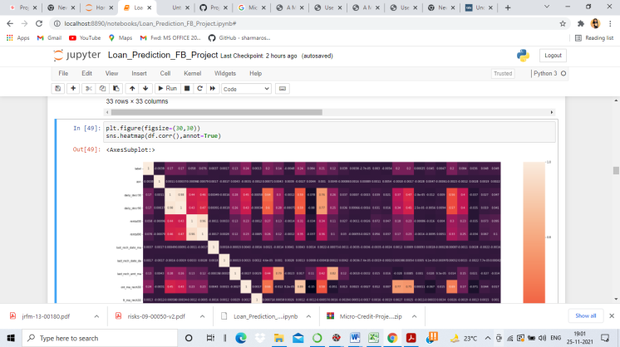
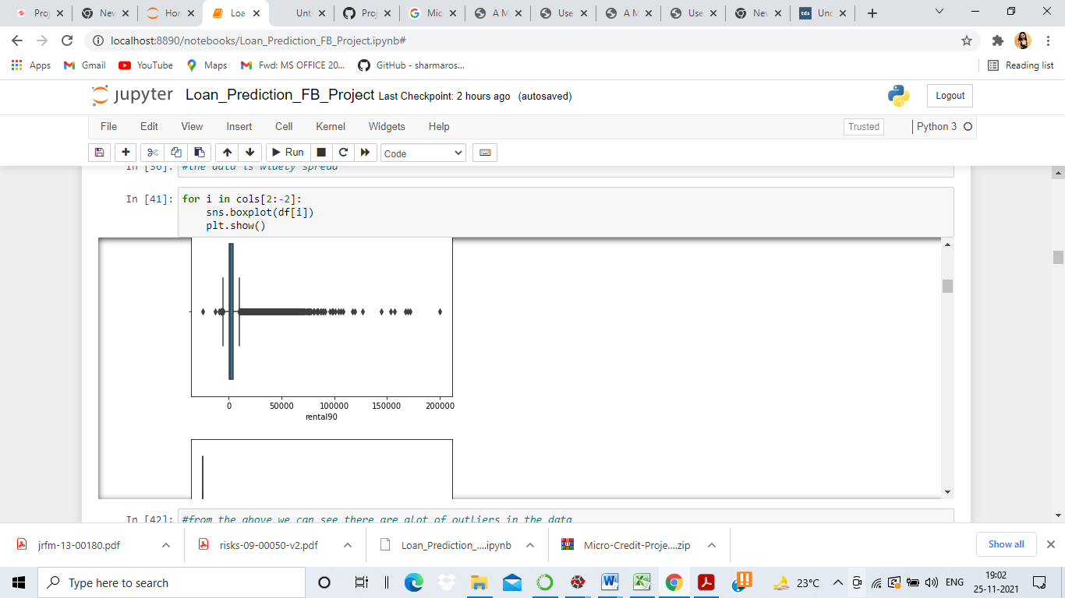
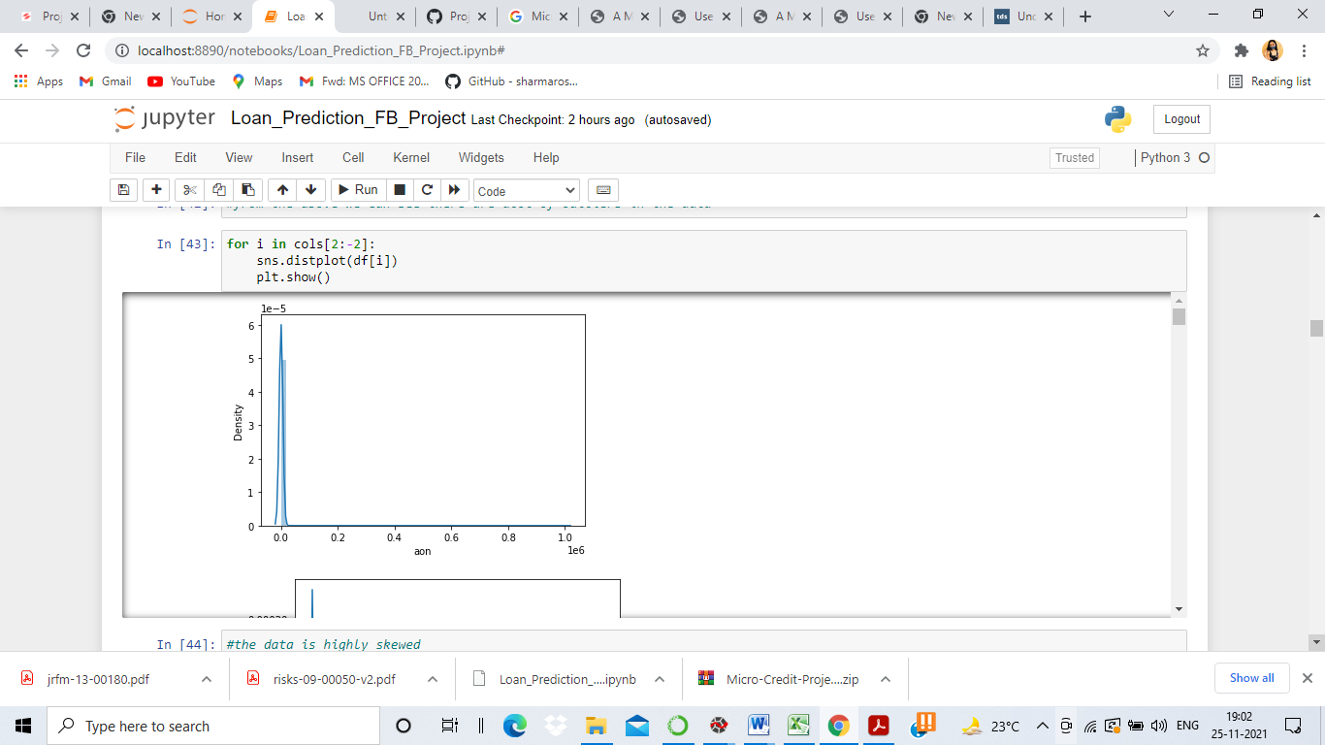
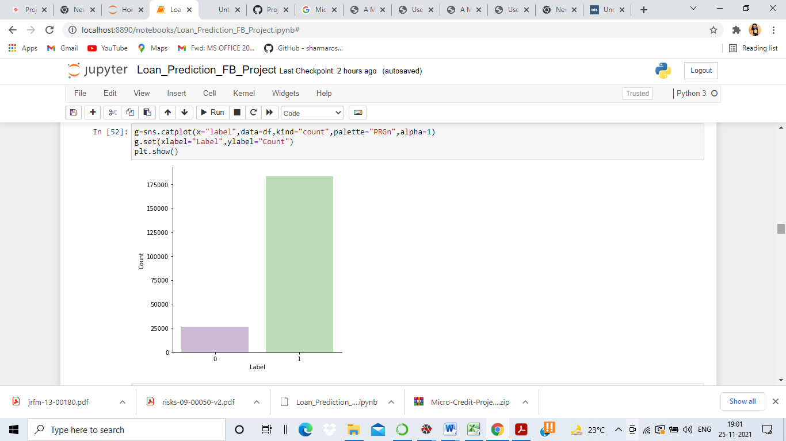
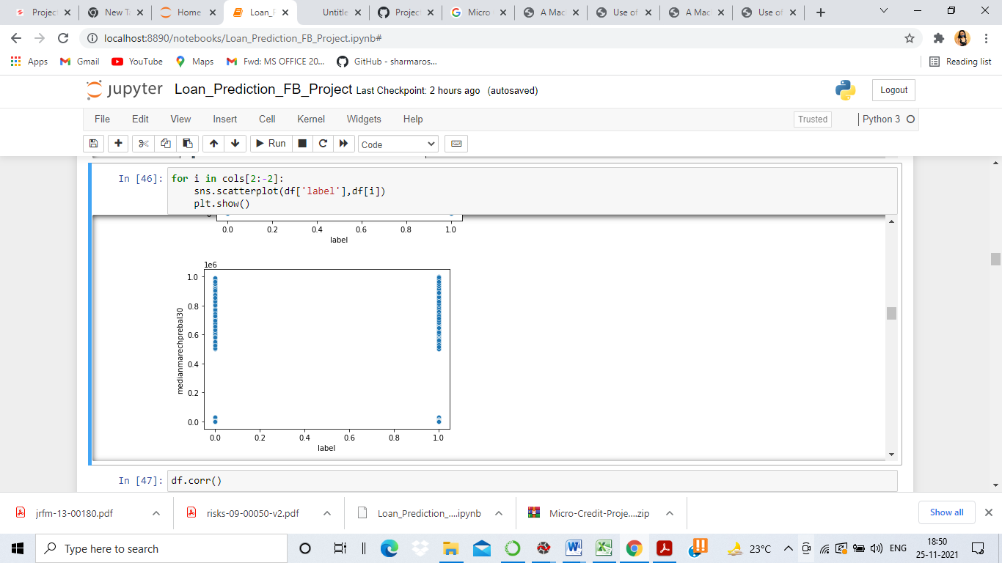
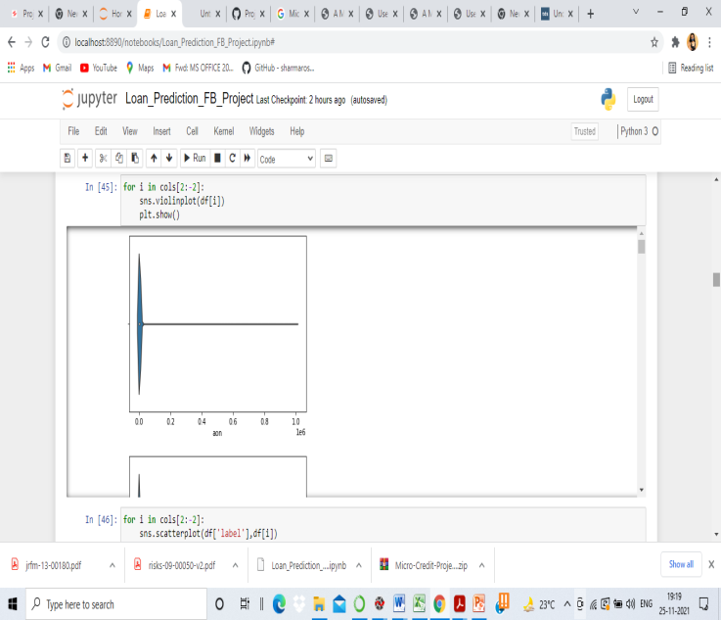
EDA and Visualization
Testing Corelation

Slide 6
Data Preprocessing
Data Preprocessing Done
Regularised the data using MinMax Scaler.- The next step is to bring the data to a common scale, since there are certain columns with very small values and some columns with high values. This process is important as values on a similar scale allow the model to learn better. We used MinMax scaler for this process
• Removed the skewness using power transform-yeo-Johnson- The Yeo–Johnson transformation allows also for zero and negative values in the dataset.
• Removed the outliers – Outliers are some miss interpreted data which could be far from the range that should be accepted. Removed outliers using the scipy.stats.zscore and removed 9% of the total data.
• The data was imbalanced – Since we had a lot of data used nearMiss (undersampling to balance the output data)
also for zero and negative values in the dataset.

Slide 7
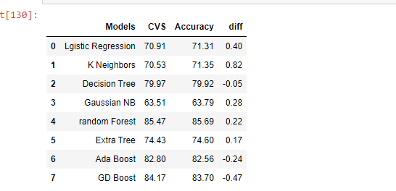
Model Development and Visualization
Different models I tried:
#From the above analysis Random Forest has least difference between r2 and cvs

Slide 8
Using hyper parameter tuning on LinearRegressor further increased the accuracy.
Random forest, like its name implies, consists of a large number of individual decision trees that operate as an ensemble. Each individual tree in the random forest spits out a class prediction and the class with the most votes becomes our model’s prediction

Slide 9
Model Evaluation using below
Hypertuning the model
GridSearch CV is a technique used to validate the model with different parameter combinations, by creating a grid of parameters and trying all the combinations to compare which combination gave the best results.
Cross Validation
We perform the cross validation of our model to check if the model has any overfitting issue, by checking the ability of the model to make predictions on new data, using k-folds. We test the cross validation for all models

Slide 10
Conclusion
Key Findings and Conclusions of the Study
The model that fits best is Random Forest
Learning Outcomes of the Study in respect of Data Science
The data was highly spread and contained a lot of skewness which was removed by yeo-johnson which reduced the skewness in data.

